Slide 1

The 5G impact on GDP, Energy Consumption, Greenhouse gas and People's Happiness
Byron
Sabique
Afonso
Rutu

Slide 2
Abstract
5G wireless network technology offers faster, lower latency, and more effective connectivity. It is designed to support a vast range of applications, including high-speed mobile broadband, ultra-reliable low-latency communication, and massive machine-to-machine communication. This report shows how 5G technology is fostering development across a range of industries, including manufacturing, healthcare, rural areas, and agriculture, and impacting Canada’s employment market and economic expansion. The report also surveys the energy efficiency of 5G network and how to support the development of ecology-friendly systems and smart communities. The final section of the report discusses how 5G will affect people’s quality of life by opening new possibilities for social interaction and entertainment and improving accesses to healthcare and education. Overall, the impact of 5G on GDP is expected to be significant, with some estimates suggesting that it could add millions of dollars to the global economy over the next decade. Not only that it will also have a significant impact on the environment and people’s quality of life.
Key Words: 5G technology, Canada GDP, Economy, Environment, Life

Slide 3
Summary
1. 5G Impact on GDP
2. 5G Impact on Energy Consumption and carbon/greenhouse gas footprint
3. 5G Impact on Canadian Quality of Life

Slide 4
1. 5G Impact on GDP
5G IN CANADA: 5G and Related Technologies Could Deliver 16%, or $120 Billion, of Canada's GDP Gr
GDP Impact Based on the Input-Output analysis
8 sectors involved in the Canadas GDP impact in our project report
Investment (Government and Private Sectors)
Labour Market
Manufacturing
IoT (Autonomous Vehicles, etc.)
Rural Area (Agriculture)
Health Care (Remote Diagnosis)
Entertainment Expense
Retail (purchase of electronic products)

Slide 5
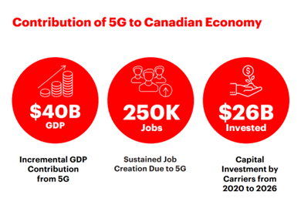
1. 5G Impact on GDP
Investment in 5G
Canada public sector spending weighed 21.7% approximately for the total Canadian GDP in 2021.
An estimation says that $28 billion investment will spend specifically in 5G network infrastructure for carriers in Canada from 2020 to 2026.
Investment from public and private sectors on 5G network creates direct contributions on GDP increase

Slide 6
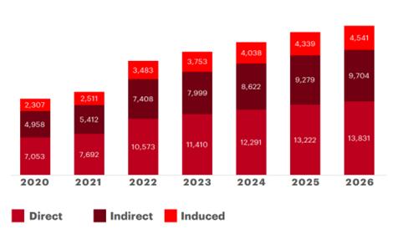
1. 5G Impact on GDP
Labour Market
In Canada, the education sector accounts for approximately 6% of total Canadian GDP.
a total of 154K temporary, direct, indirect, and induced jobs will be created between 2020 and 2026.

Slide 7
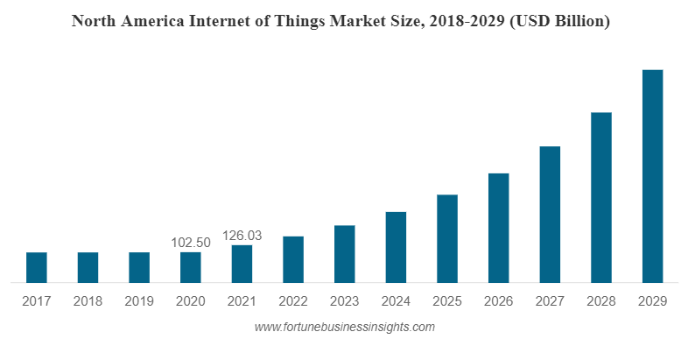
1. 5G Impact on GDP
Manufacturing and IoT
Predicting around $230 billion)uplift to the nation’s economy over the next 10 years as IoT
The manufacturing industry accounts for more than 10% of Canada's total GDP.
The manufacturing industry will benefit the most from 5G technology. 5G networks offer manufacturing companies the ability to build smart factories and take advantage of technologies such as automation, artificial intelligence, etc.

Slide 8

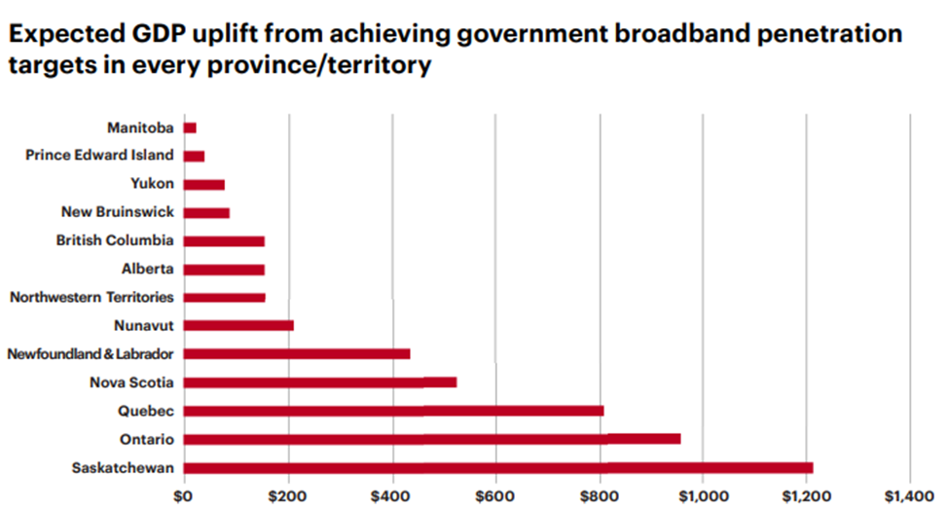
1. 5G Impact on GDP
Impact on Agriculture
7%, or $111.9B, of Canada’s GDP coming from the agriculture and agri-food system
Using remote sensors can reduce the use of pesticides by 85% Reducing $360M CAD for the canola industry in Saskatchewan
Impact on Rural Area
By 2026 Govt of Canada wants to achieve 95% Broadband coverage

Slide 9

1. 5G Impact on GDP
Impact on Healthcare
On average, each person in Canada spends around $6,839 annually on medical care.
In 2018, the Canadian government allocated more than $240 billion to healthcare.
The total spending on health makes up about 11.3% of Canada's GDP
Improved treatment in the ambulance could result in a 20% reduction in the average length of hospital stay the healthcare system could save $140 million

Slide 10

1. 5G Impact on GDP
Impact on Entertainment/Gaming/Education/Retail
Improved live event experiences with AR and multiple view angles
B.C. immersive technology companies generated $2.3B in annual revenues which is 35% of all AR/VR revenue activity in Canada
5G will revolutionize classrooms with AR/VR technologies
Retail sector GDP accounts for approximately 5% of total GDP

Slide 11
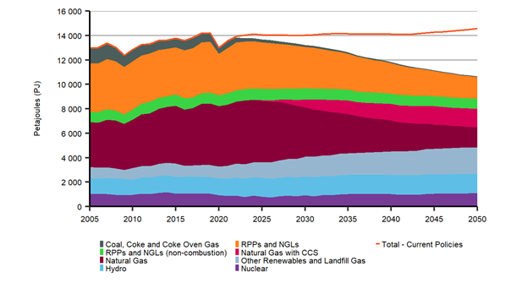
2. 5G Impact on Energy Consumption and carbon/green house gas footprint
The Canadian’s plan contains retrofitting buildings and delivering more energy-efficient transit options
5G wireless technology is central to reaching Canada’s carbon emission reduction commitments.

Slide 12
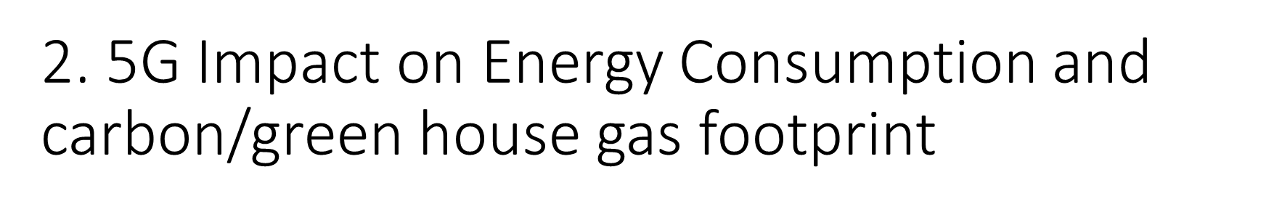
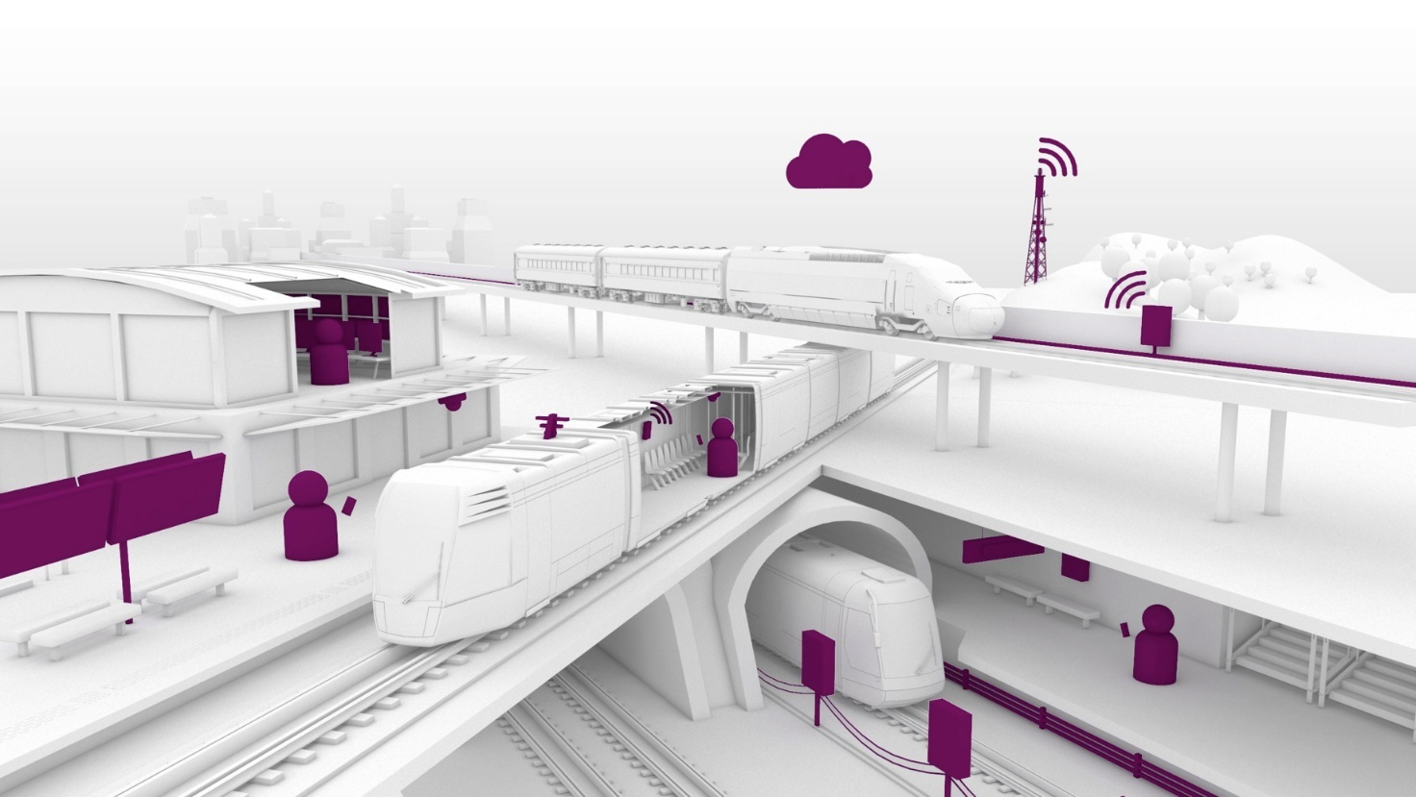
Think about:
in quick maintenance/repair time (less operating time)
increased confidence in public transport (less cars and emission)
Smart cities, adjusted buildings (HVAC, lighting)
smart transportation to optimize vehicle traffic patterns and diminish congestion
Extended reality (XR) technologies that delivery the remote work

Slide 13
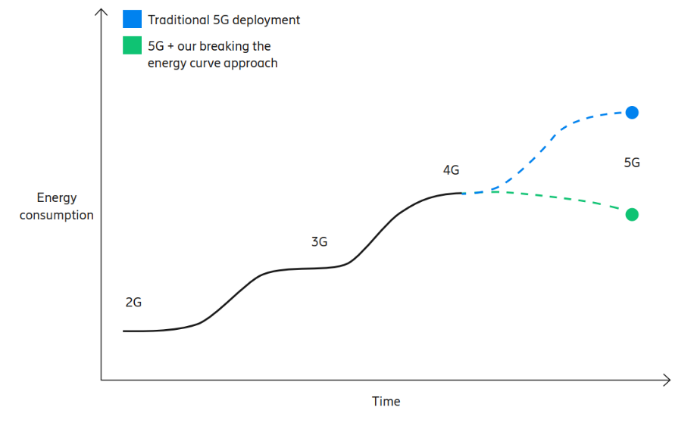
Carbon dioxide emission drop (2025) | 48-54 million (metric) tons
Passenger vehicles off the street | 10.5 million

Slide 14
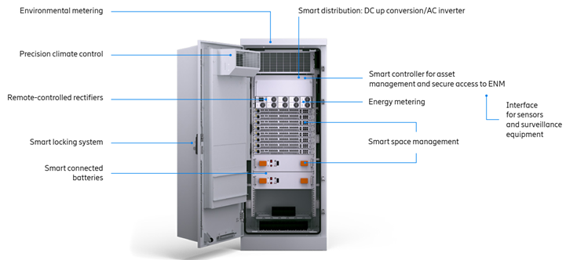
Formulate the network (core, transport, Radio access and infra)
Trigger energy-saving software
Build 5G with accuracy and Run site infrastructure intelligently (autonomous systems, AI)

Slide 15
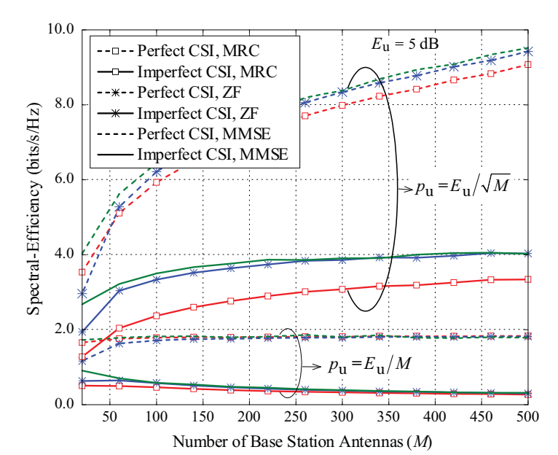
Spectral efficiency versus the number of BS antennas
The goal is to repeat the experiment and visualize how the number of antennas affects the energy, using Matlab

Slide 16
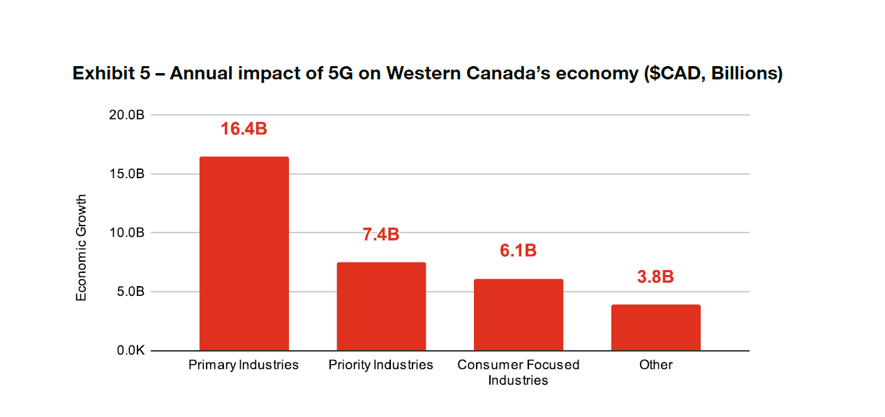
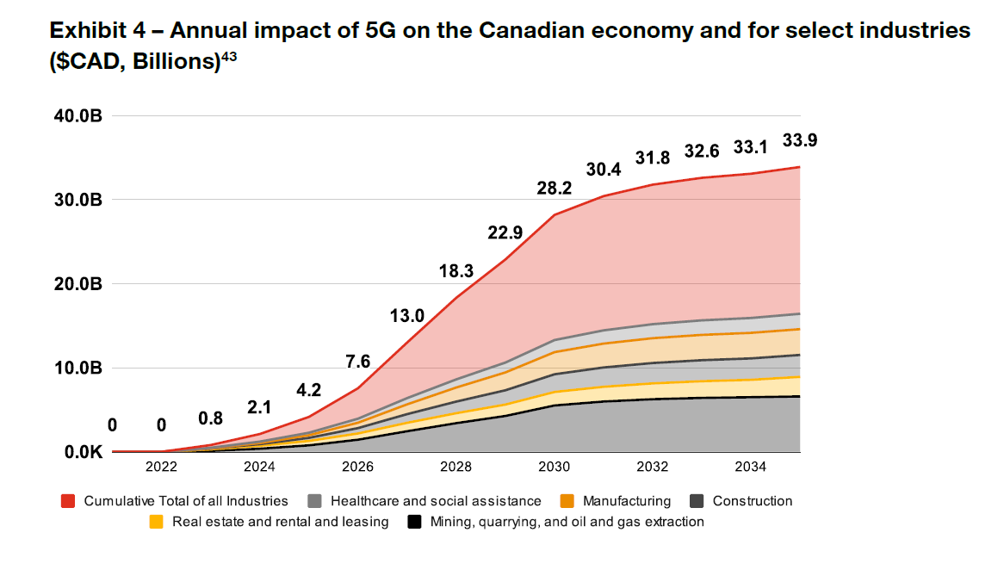
3. 5G Impact on Canadian Quality of Life

Slide 17

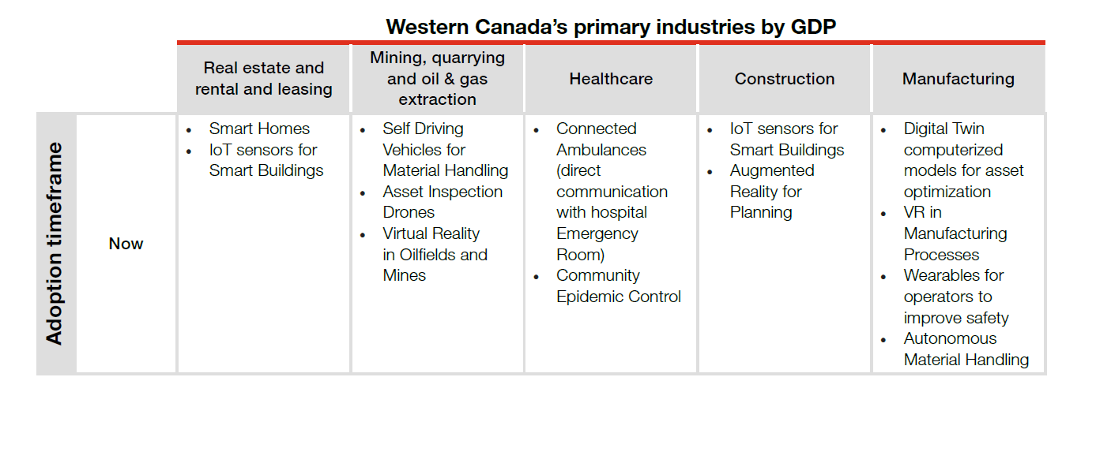
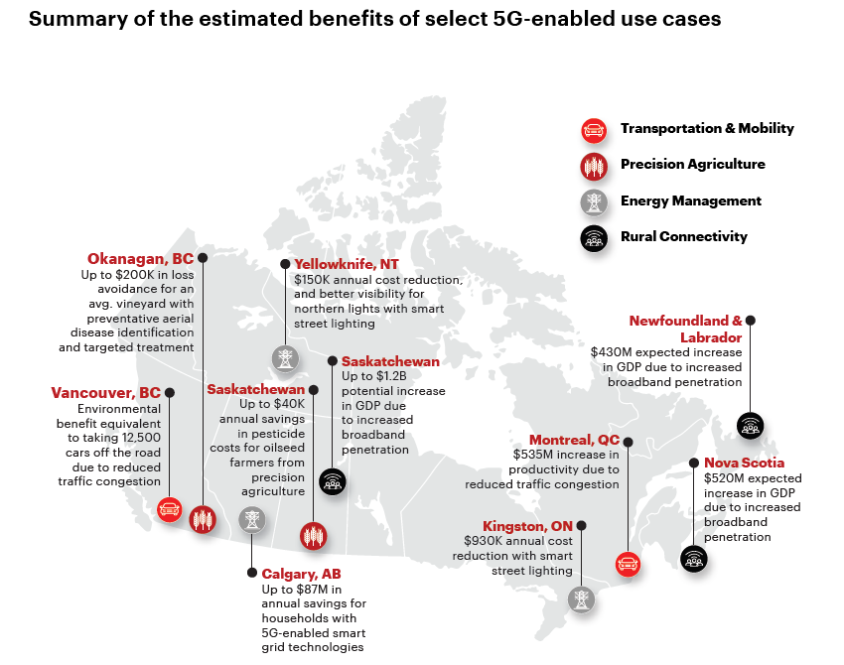

Slide 18
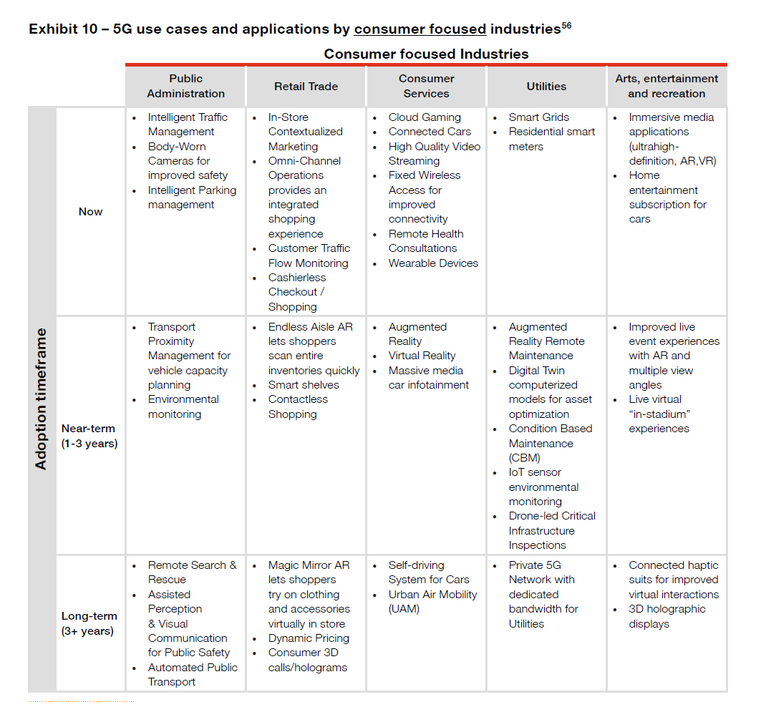

Slide 19
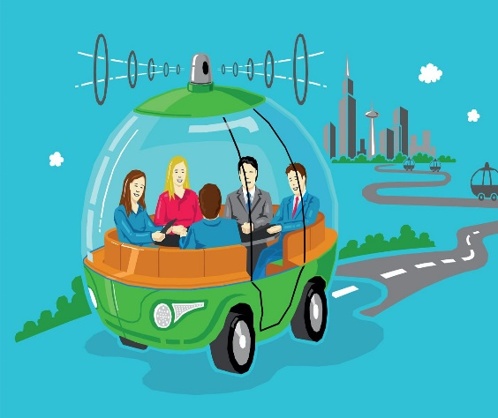
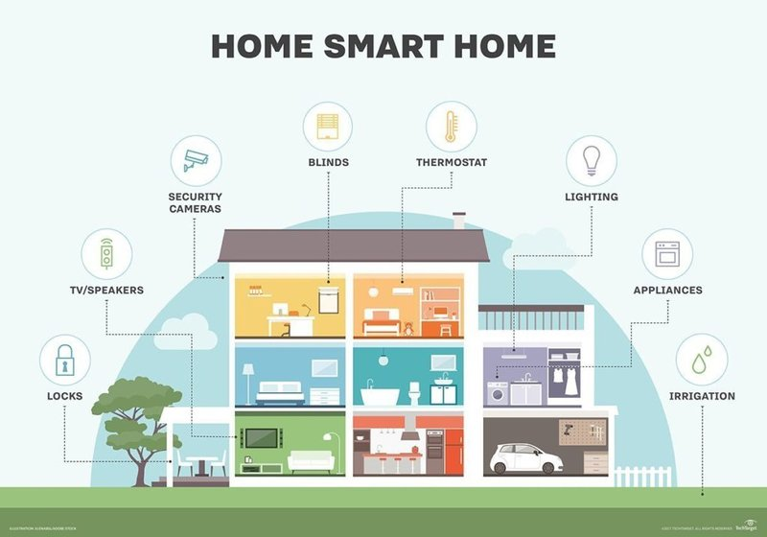
Automated vehicle & Smart Home

Slide 20

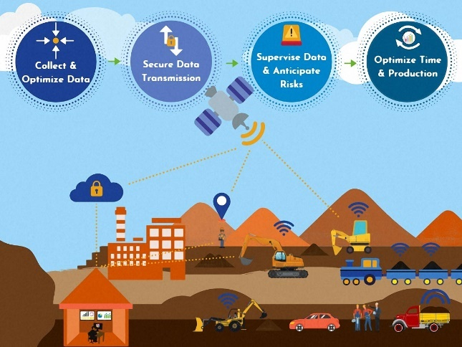
Smart Hospital & Smart mining

Slide 21
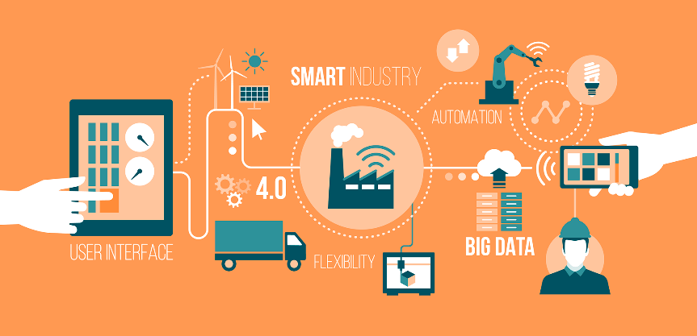
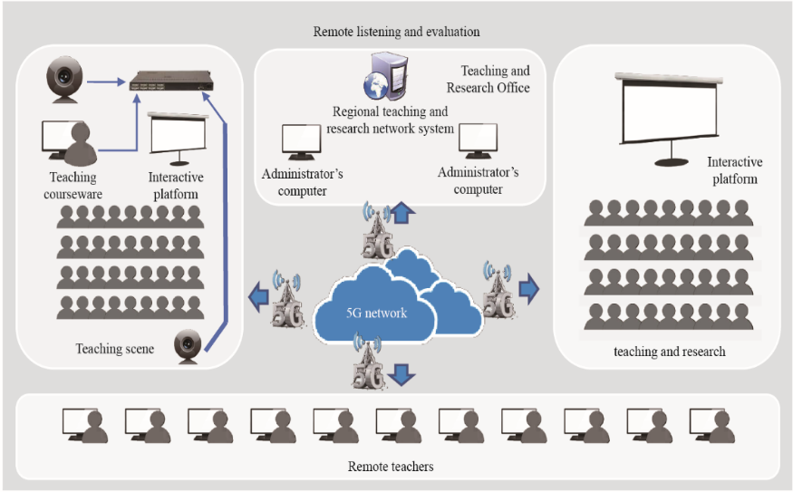
Smart Industry 4.0 & Smart School

Slide 22
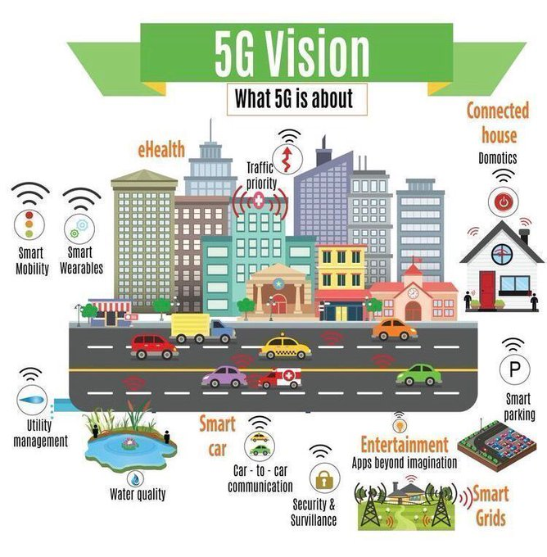
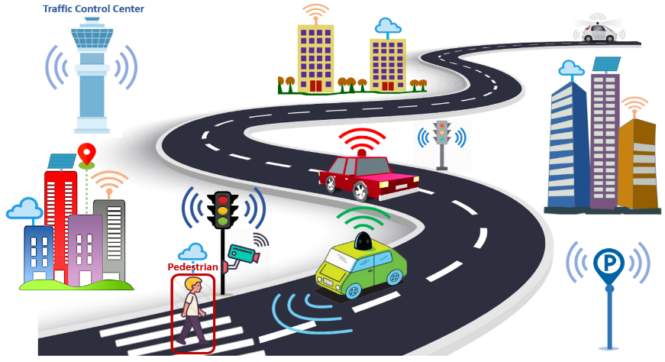
smart Transportation system & Smart City

Slide 23
Thank you

